Slide 1
CHAPTER 10 - TREES
Notes:
Chapter 10 - Trees

Slide 2
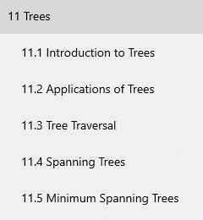
Our goal

Slide 3
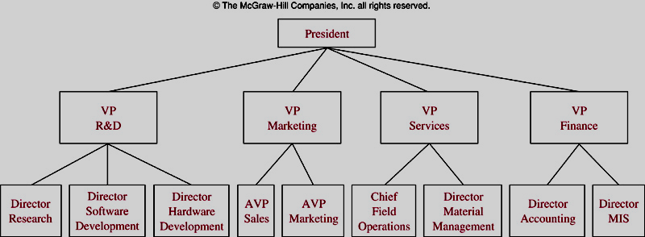
Some Tree Models
A Organizational Tree
Notes:
The structure of a large organization can be modeled using a rooted tree.
Vertices are positions in the organization.
An edge from one vertex to another indicates that the person represented by the initial vertex is the (direct) boss of the person represented by the terminal vertex.
Chapter 10 - Trees

Slide 4
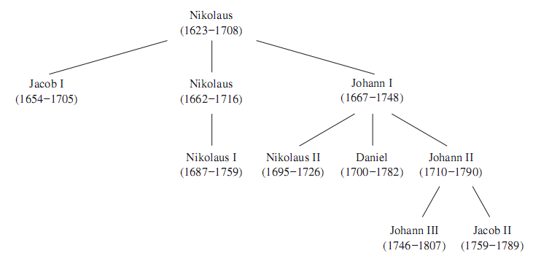
Family tree

Slide 5
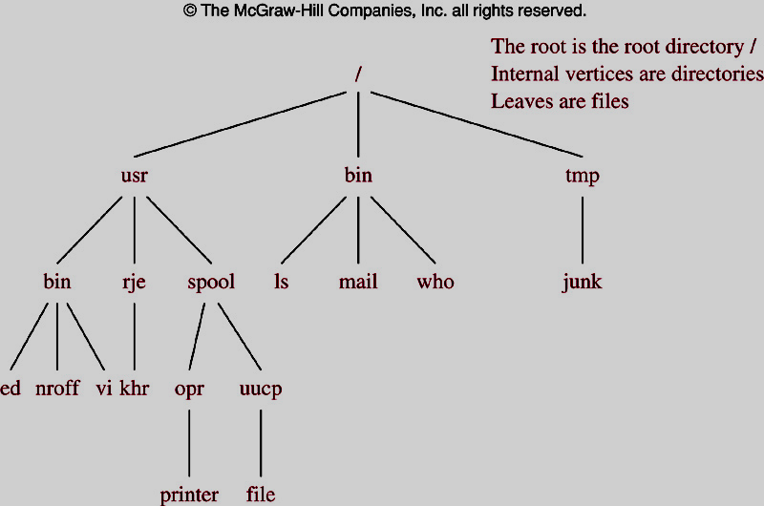
Some Tree Models
A Computer File System
Notes:
-
Chapter 10 - Trees

Slide 6
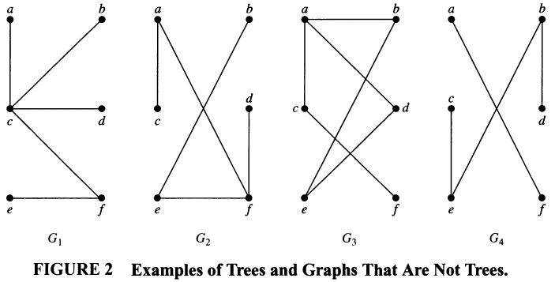
Introduction to Trees
circuit
disconnected
Notes:
Chapter 10 - Trees

Slide 7
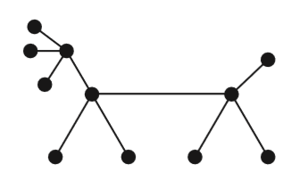
Trees
Theorem.
An undirected graph is a tree if and only if there is a unique simple path between any two of its vertices.

Slide 8
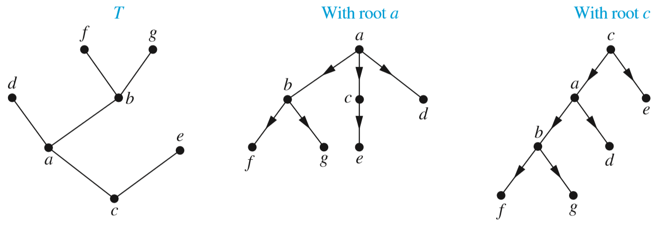
Rooted trees
A rooted tree is a tree in which one vertex has been designated as the root

Slide 9
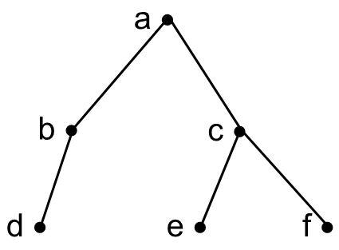
Terminologies
root
Parent of e, f
A child of c

Slide 10
Terminologies
root
a •
b •
c •
Internal nodes: nodes have children
d •
e •
f •
leaves: nodes without children

Slide 11
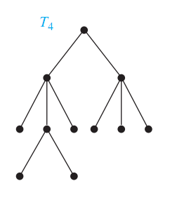
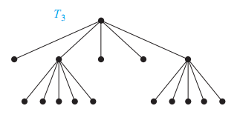
Full m-ary trees
•
•
m = 3: Ternary tree
Full Ternary tree
m read
1 Uniry
2 Binary
3 Ternary
4 Quaternary
5 Quinary
6 Senary
Etc.
Full
5-ary tree

Slide 12
Full m-ary trees
a •
a •
b •
c •
b •
c •
d •
d •
g •
m=2: binary tree T
A full binary tree T

Slide 13
Binary tree
a •
b •
c •
d •
e •
f •
b •
c •
A binary tree T
d •
e •
f •
Left subtree of T
Right subtree of T

Slide 14
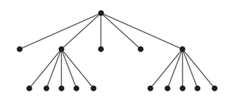
Properties of Trees
A tree with n vertices has n-1 edges #n: Number of nodes
For a full m-ary tree:
  n = mi + 1 // i : Number of internal nodes
  n = i +  //  : Number of leaves
m = 5
i = 3
n = 5.3 + 1 = 16

Slide 15
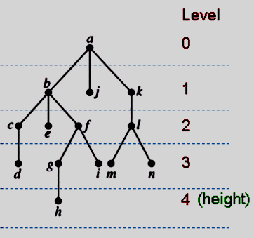
Introduction to Trees…
Level of a vertex: The length of the simple path from the root to this vertex.
Height of Tree = the maximum of levels
Notes:
Note that there exists a rooted tree of height 0.
The height of a rooted tree is the length of the longest path from the root to any vertex.
Chapter 10 - Trees

Slide 16
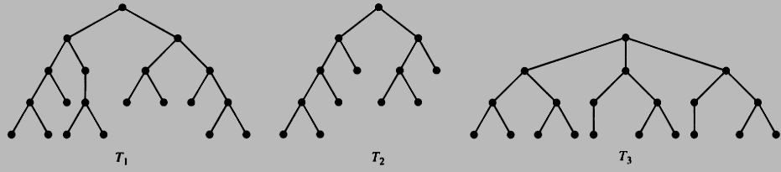
Introduction to Trees…
A m-ary tree is called balanced if all leaves are at levels h or h-1. // h = height
h=4
All leaves are at levels 3, 4
→ Balanced
h=4
All leaves are at levels 2, 3, 4
→ Not Balanced
h=3
All leaves are at levels 3
→ Balanced

Slide 17
10.2- Applications of Trees
Binary Search Trees
Decision Trees
Prefix Codes
Notes:
We will discuss three problems that can be studied using trees.
The first problem is: How should items in a list be stored so that an item can be easily located?
The second problem is: What series of decisions should be made to find an object with a certain property in a collection of objects of a certain type?
The third problem is: How should a set of characters be efficiently coded by bit strings?
Chapter 10 - Trees

Slide 18
Binary search tree
A binary tree where each vertex is labeled with a key
the key of a vertex is both larger than the keys of all vertices in its left subtree and smaller than the keys of all vertices in its right subtree.
k
< k
> k

Slide 19
Binary search tree - Add a new vertex
9
Starting at the root
7
9 > 7
How to add 9 to the binary search tree ?
5
11
9 <11
1
10
17
9 < 10
9
add 9 as a left child

Slide 20
Constructing a binary search tree
Binary search tree for words: mango, cherry, grape, apple, guava, watermelon, satsuma, banana
smaller key ➔ go/add to the left
greater key ➔ go/add to the right
• mango
• cherry
• watermelon
• apple
• grape
• satsuma
• banana
• guava

Slide 21
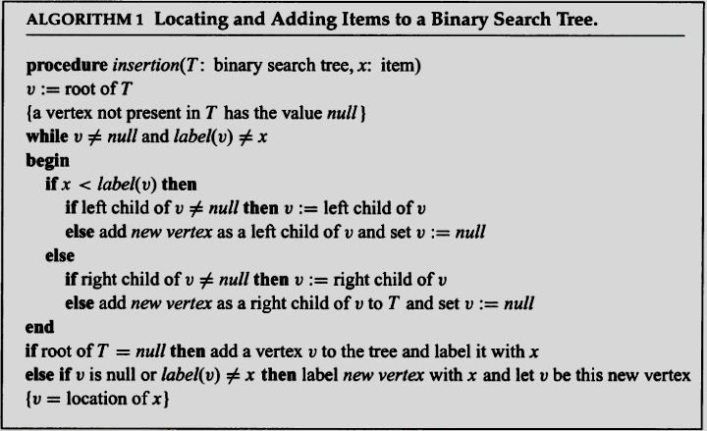
Algorithm for inserting an element to BST
Complexity: O(logn)
Proof: page 698
Notes:
v is the vertex currently under examination and label(v) represents the key of this vertex.
The algorithm begins by examining the root. If the x equals the key of v, then the algorithm has found the location of x and terminate s; if x is less than the key of v, we move to the left child of v and repeat the procedure; and if x is greater than the key of v, we move to the right child of v and repeat the procedure.
If at any step we attempt to move to a child that is not present, we know that x is not present in the tree, and we add a new vertex as this child with x as its key.
Chapter 10 - Trees

Slide 22
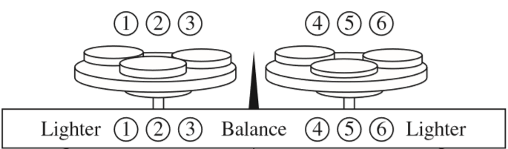
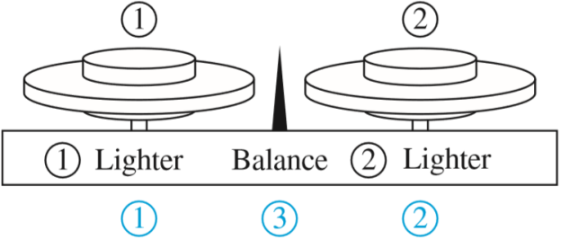
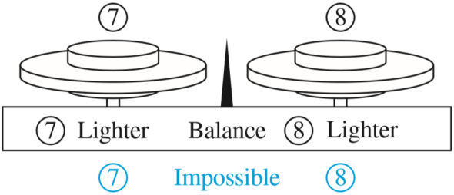
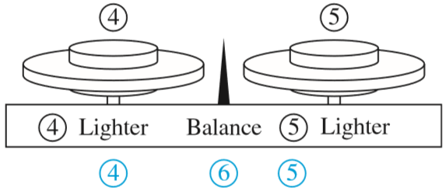
Decision Trees
The Counterfeit Coin Problem.
8 coins, 1 fake coin (counterfeit, lighter) 
Use a two-pan balance scale to determine the lighter one.
How many weightings are necessary?
Lighter
Balance
Lighter
Notes:
Rooted trees can be used to model problems in which a series of decisions leads to a solution. For example, suppose there are seven coins, all with the same weight, and a counterfeit coin that weighs less than the others. How many weighings are necessary using a balance scale to determine which of the eight coins is the counterfeit one?
It is possible to determine the counterfeit coin using two weighings. The decision tree that illustrates how this is done is shown in the given Figure.
Chapter 10 - Trees

Slide 23
Prefix Codes
Introduction to Prefix Codes
Huffman Coding Algorithm
Notes:
Chapter 10 - Trees

Slide 24
Introduction
Standard ASCII character encoding: use 8 bits (1byte) to store each character.
For example, using the standard ASCII encoding, the 12-character string “no one knows“ requires 12*8 = 96 bits total.
char ASCII bit pattern
n 110 01101110
o 111 01101111
e 101 01100101
k 107 01101011
w 119 01110111
s 115 01110011
space 32 00100000

Slide 25
A better code scheme
Use 12*3 = 36 bits
char number bit pattern
n 0 000
o 1 001
e 2 010
k 3 011
w 4 100
s 5 101
space 6 110

Slide 26
A variable-length encoding
Use 32 bits
This is our goal
char bit pattern
n 01
o 11
e 000
k 001
w 1000
s 1001
space 101
Prefix code

Slide 27
Prefix codes
Consider the codes:
(i) a: 10 e: 01 i: 0110 t: 11
➔ Not a prefix code
Based on this code, the message 011011 can be decoded as it or eat
(ii) a: 10 e: 01 i: 001 t: 11
➔ Prefix code
Based on this code, the message 110110 can be decoded as tea

Slide 28
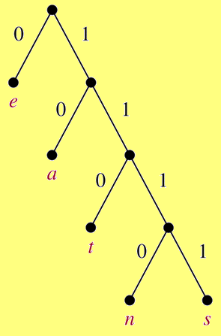
Binary trees used to construct prefix codes

Slide 29
Prefix Codes
Construct a binary tree with a prefix code.
sane will be store as
11111011100 ➔ 11 bits
11111011100 : s
11111011100 : a
11111011100 : n
11111011100 : e
ASCII uses 32 bits to store sane
Compression factor: 32/11 ~ 3
Notes:
Codes with property that the bit string for a letter never occurs as the first part of the bit string for another letter are called prefix codes.
Chapter 10 - Trees

Slide 30
Prefix Codes: Huffman Coding Algorithm
Counting occurrences of characters in a text ➔ frequencies (probabilities) of each character.
Constructing a binary tree representing prefix codes of characters.
The set of binary codes representing each character.
Coding source text
Notes:
- Note that this algorithm assumes that we can compute the frequency of each symbol by dividing the number of times this symbol occurs
by the length of the string.
- Huffman coding is a fundamental algorithm in data compression, the subject devoted to reducing the number of bits required to represent information. Huffman coding is extensively used to compress bit strings representing text and it also plays an important role in compressing audio and image files.
Chapter 10 - Trees

Slide 31
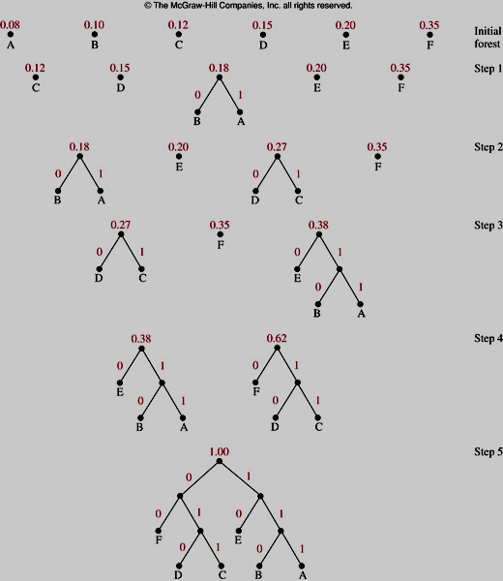
Prefix Codes: Huffman Coding Algorithm
Notes:
At each step, we combine two trees having the least total weight into a single tree by introducing a new root and placing the tree with larger weight as its left subtree and the tree with smaller weight as its right subtree.
We assign the sum of the weights of the two subtrees of this tree as the total weight of the tree.
When the forest is reduced to a single tree → stop.
Chapter 10 - Trees

Slide 32
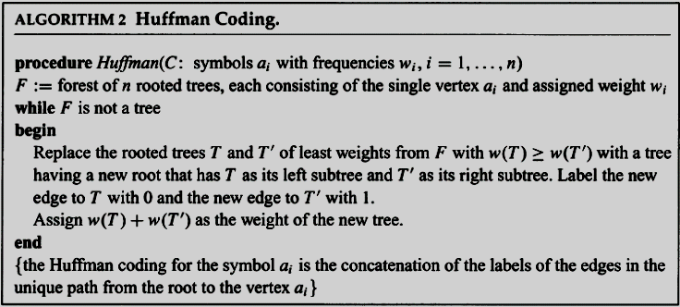
Prefix Codes: Huffman Coding Algorithm

Slide 33
Traversal Algorithms
At a time, a vertex is visited
Recursive algorithm
Traversals are classified into:
  Pre-order traversal. N L R // N: root node
  In-order traversal. L N R // L: left subtree
  Post-order traversal. L R N // R: right subtree
Notes:
- Ordered rooted trees are often used to store information. We need procedures for visiting each vertex of an ordered rooted tree to access data. We will describe several important algorithms for visiting all the vertices of an ordered rooted tree.
Chapter 10 - Trees

Slide 34
Tree traversals
a
•
•
b
•
c
•
d
Pre-order traversal:
N L R
a b c d
in-order traversal:
L N R
b a c d
post-order traversal:
L R N
b c d a

Slide 35
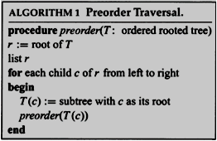
Preorder traversal - example
a
•
Pre-order traversal: N L R
•
b
•
c
•
d
a
•
•
b
•
c
•
d
•
e
•
f
•
g
•
h
•
e
•
f
•
g
•
h
a b e f c d g h

Slide 36
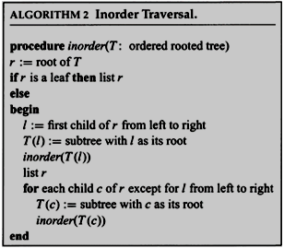
Inorder traversal - example
a
•
in-order traversal: L N R
•
b
•
c
•
d
a
•
•
b
•
c
•
d
•
e
•
f
•
g
•
h
•
e
•
f
•
g
•
h
e b f a c g d h

Slide 37
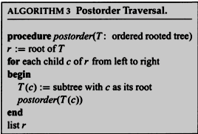
Postorder traversals - examples
a
•
post-order traversal: L R N
•
b
•
c
•
d
a
•
•
b
•
c
•
d
•
e
•
f
•
g
•
h
•
e
•
f
•
g
•
h
e f b c g h d a

Slide 38
Tree traversals - examples
Construct a binary search tree for the numbers:
8, 11, 3, 6, 9, 1, 13, 7, 21
What are the order of numbers after applying:
- preorder traversal
- inorder traversal
- postorder traversal?
8
•
Preorder traversal:
8 3 1 6 7 11 9 13 21
11
•
3 •
Inorder traversal:
1 3 6 7 8 9 11 13 21
•
1
•
6
•
9
• 13
Sorted
•
7
•
21
Postorder traversal:
1 7 6 3 9 21 13 11 8
Binary search tree

Slide 39
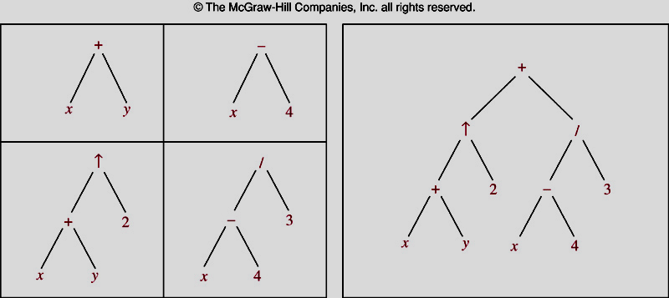
Infix, Prefix, and Postfix Notation
Expression Trees
Notes:
We can represent complicated expressions, such as compound propositions, combinations of sets, and arithmetic expressions using ordered rooted trees.
+ represents addition, - represents subtraction, * represents multiplication, / represents division and  represents exponentiation
Chapter 10 - Trees

Slide 40
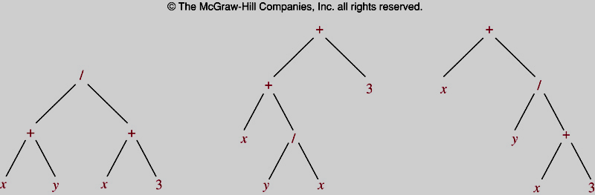
Infix, Prefix, and Postfix Notation
Expression Trees
Notes:
Inorder traversals of the binary trees in Figure 11, which represent the expressions (x + y)/(x + 3), (x + (y/x))+ 3, and x + (y/(x + 3)), all lead to the infix expression x + y/x + 3.
To make such expressions unambiguous it is necessary to include parentheses in the inorder traversal whenever we encounter an operation.
Chapter 10 - Trees

Slide 41
Infix, Prefix, and Postfix Notation
Infix form:
  operand_1 operator operand_2 x + y
Prefix form:
  operator(operand_1,operand_2) + x y
Postfix form:
  (operand_1,operand_2)operator x y +
How to find prefix and postfix form from infix form?
  (1) Draw expression tree.
  (2) Using Preorder traverse → Prefix form
  Using Postorder traverse → Postfix form
Notes:
Chapter 10 - Trees

Slide 42
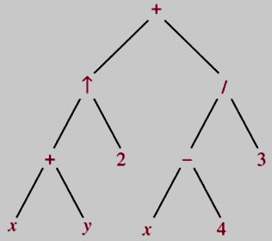

Infix, Prefix, and Postfix Notation
Infix form
Prefix form
Postfix form
Notes:
Chapter 10 - Trees

Slide 43
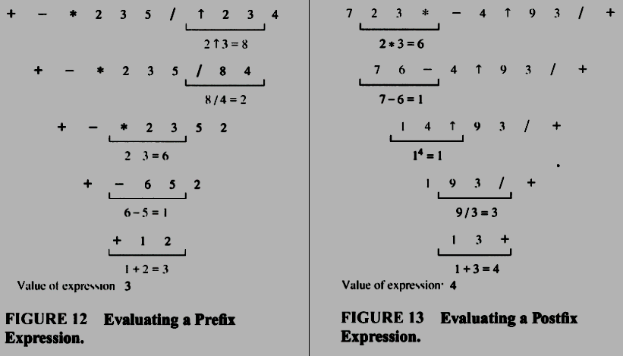
Infix, Prefix, and Postfix Notation
Notes:
Find the value of the value of the prefix expression + - * 2 3 5 /  2 3 4?
Chapter 10 - Trees

Slide 44
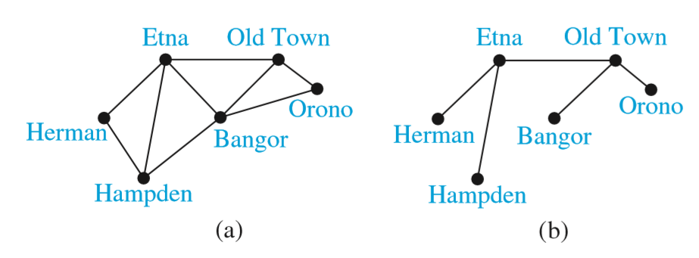
Spanning trees

Slide 45
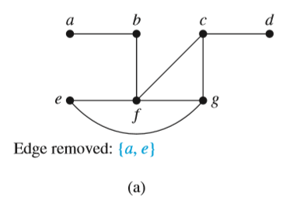
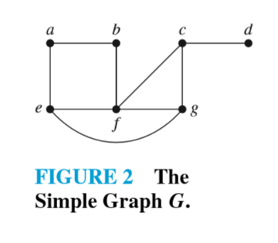
Spanning trees
Definition.
Let G be a simple graph. A spanning tree of G is a subgraph of G that is a tree containing every vertex of G.

Slide 46
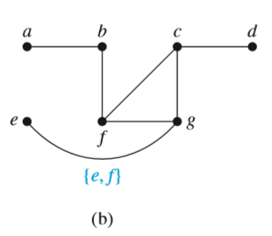
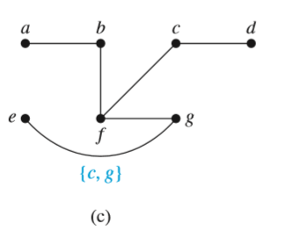
Remov EdgesThat Form Simple Circuits.

Slide 47
THEOREM 1
A simple graph is connected if and only if it has a spanning tree.

Slide 48
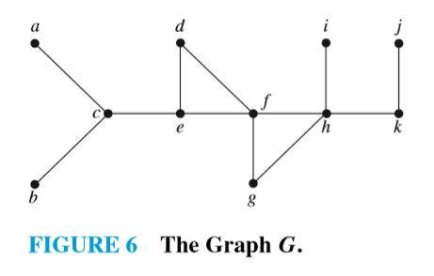
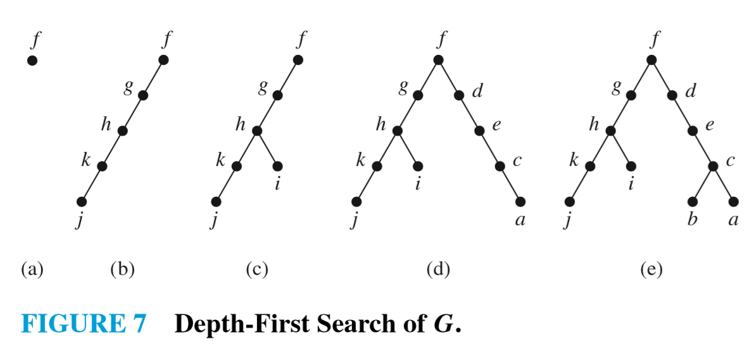
Depth-First Search

Slide 49
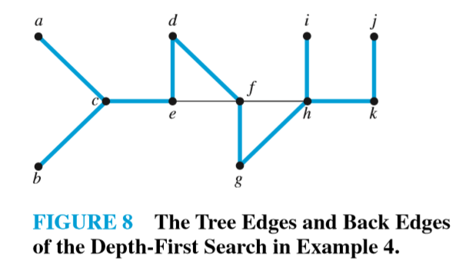
The edges selected by depth-ﬁrst search of a graph are called tree edges.
All other edges are called back edges.

Slide 50
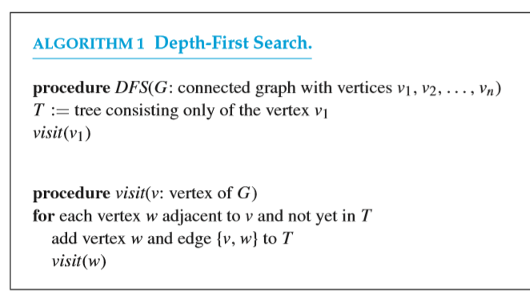

Slide 51
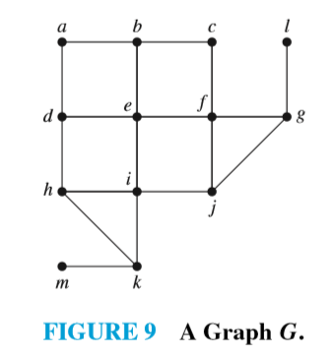
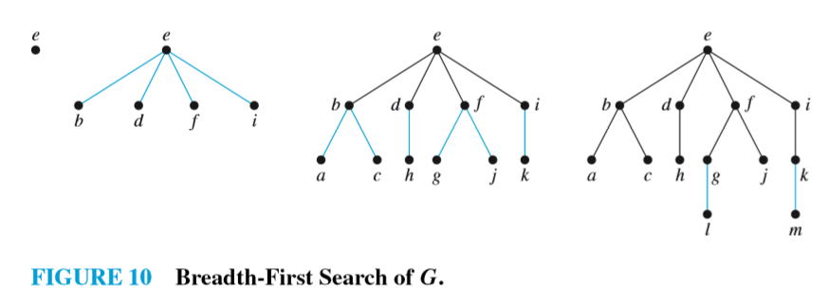
Breadth-First Search

Slide 52
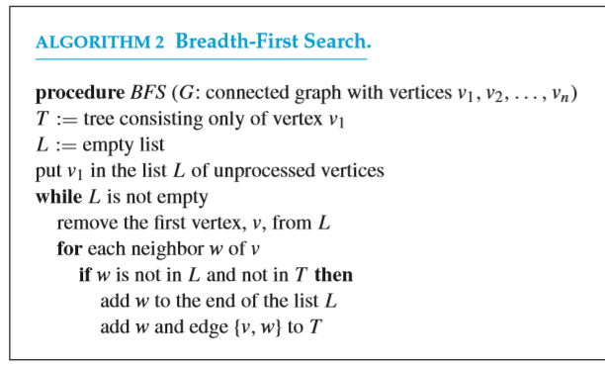

Slide 53
Backtracking Applications
Graph Colorings
Then-Queens Problem
Sums of Subsets

Slide 54
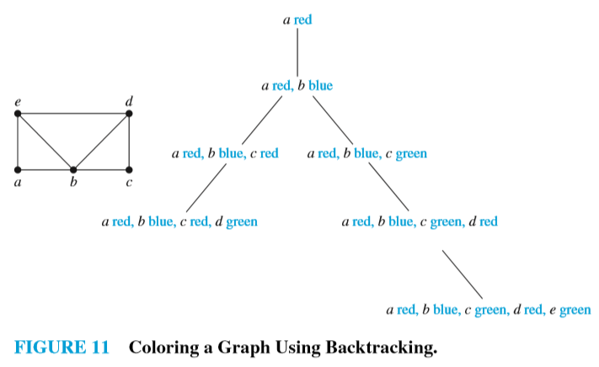
Graph Colorings - example

Slide 55
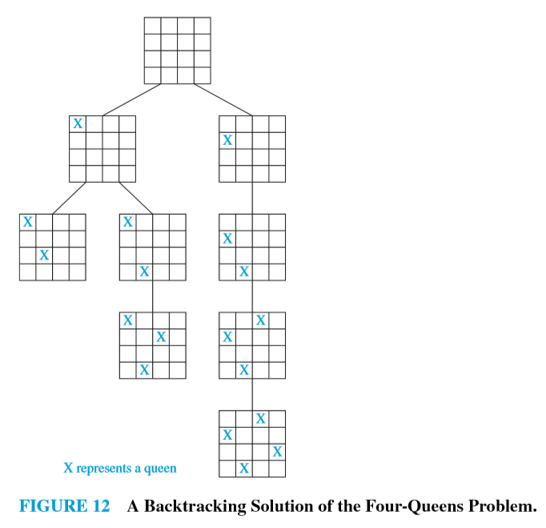
The n-Queens Problem

Slide 56
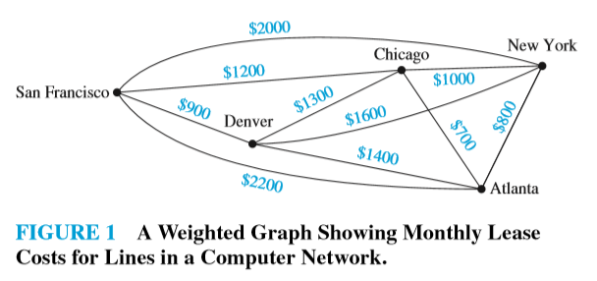
Minimum Spanning Trees
Which links should be made to ensure that there is a path between any two computer centers so that the total cost of the network is minimized?
➔ minimum spanning tree: a spanning tree that has the smallest possible sum of weights of its edges.

Slide 57
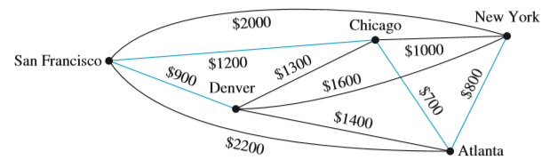
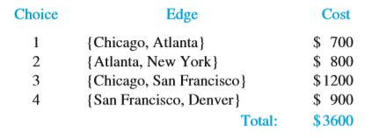
Algorithms for Minimum Spanning Trees
Prim’s algorithm (1957 by Robert Prim) (originally discovered by Vojtech Jarník in1930).
Choosing any edge with smallest weight, putting it into the spanning tree.
Add to the tree edges of minimum weight that are incident to a vertex already in the tree, never forming a simple circuit with those edges already in the tree.
Stop when n−1 edges have been added.

Slide 58
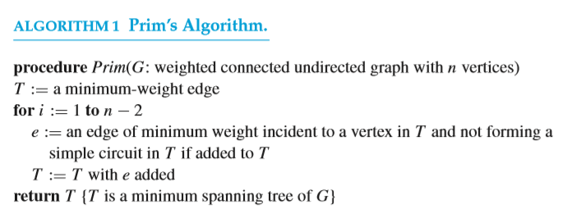
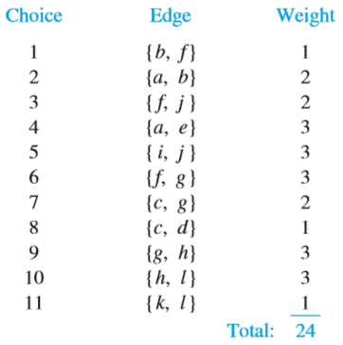
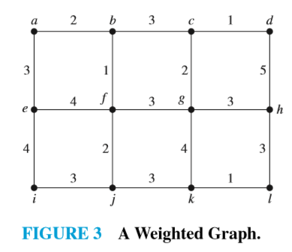

Slide 59
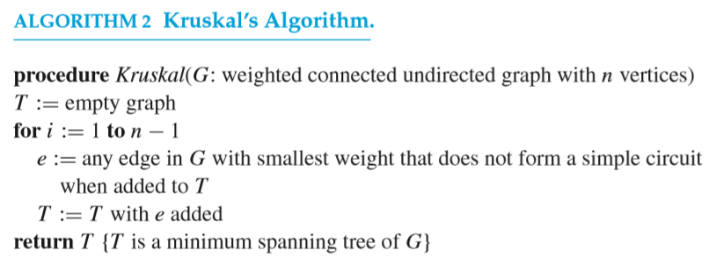
Kruskal’s algorithm (by Joseph Kruskal in 1956)
Choose an edge in the graph with minimum weight.
Add edges with minimum weight that do not form a simple circuit with those edges already chosen.
Stop after n−1 edges have been selected.

Slide 60
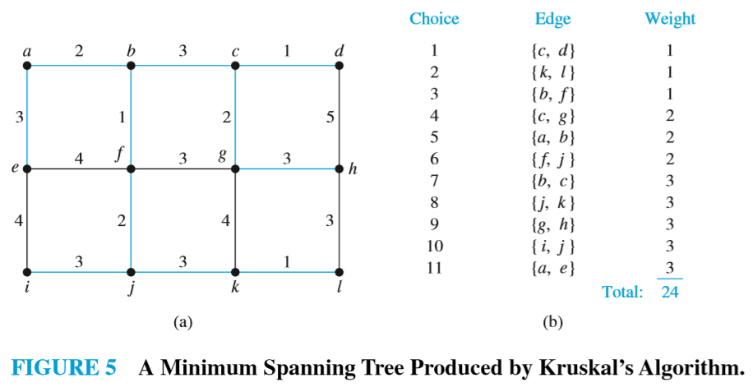

Slide 61
Summary

Slide 62
Thanks

